Slide 1

POORNIMA INSTITUTE OF ENGINEERING &TECHNOLOGY JAIPUR
DEPARTMENT OF COMPUTER SCIENCE
INDUSTRIAL TRAINING PRESENTATION
ON
PYTHON BASIC
Presented by - ISHU KUMAR Guided by - Department of CS
Reg no. - PIET20CS080
Year - 2nd

Slide 2

FROM WHERE I HAVE COMPLETED MY INTERN ?

Slide 3
COURSERA
In 2012, coursera founder Koller built a software for a living virtual classroom Coursera is a global online learning platform that offers anyone, anywhere, access to online courses and degrees from leading universities and companies.

Slide 4
TOPICS I HAVE LEARND !!
Comment .
String .
Tuples .
Dictionaries .
If – else .
Loops (for and while) .
Function .
File
And some more .

Slide 5
* COMMENT :- Comment are two type 1. # - single line comment 2. ‘‘‘ ’’’ - multi line comment * STRING :- Strings in python are surrounded by either single quotation marks, or double quotation marks. Eg. a = “hello” print(a)

Slide 6
* Tuples : - Tuples are used to store multiple items in a single variable. Eg maggi = ("apple", "banana", "cherry") print(maggi) * Dictionary :- Dictionaries are used to store data values in key value (:) eg – name = {‘sorry’:1000 , ‘chance’:1} print(name[sorry])

Slide 7
* If else statement : - Checking the condition whether the condition is true or false . Eg – a = 33 ; b = 200 if b > a: print("b is greater than a") else : print(“less”)

Slide 8
* Loops :- For loop and while loop 1. for loop – Repeating the statement multiple time 2 . While loop – when the condition is true the loop will work otherwise not.

Slide 9
* Function :- A function is a block of code which only runs when it is called. * Files : - opening the file and closing the file

Slide 10
MY PROJECT IS
Web browser .
In which I have named my browser a DORAEMON.

Slide 11
WHY I AM CHOOSING THIS PROJECT
To make it fast .
Used easily.

Slide 12
IMPORTANTS MARKS
DORAEMON.
To make a fast or safe browser in which we focused on privacy .
It is based on python.
PROJECT TYTLE
PROJECT OBJECTIVE
PROJECT TECHNOLOGY

Slide 13
FUTHER PLANE OF THIS
Firstly I have learnt PYTHON thoroughly and than I have focused on this project.
Now I have focus of on my coding .

Slide 14
PROJECT OUTCOME
The main purpose of making this projects is to making it fast and secure search engine.
It is application software for accessing the World Wide Web. When a user follows the URL of a web page from a particular website .
Web browsers are used on a range of devices, including desktops, laptops, tablets, but my project is fully desktop mode.

Slide 15
CODE OF MY PROJECT : -

Slide 16
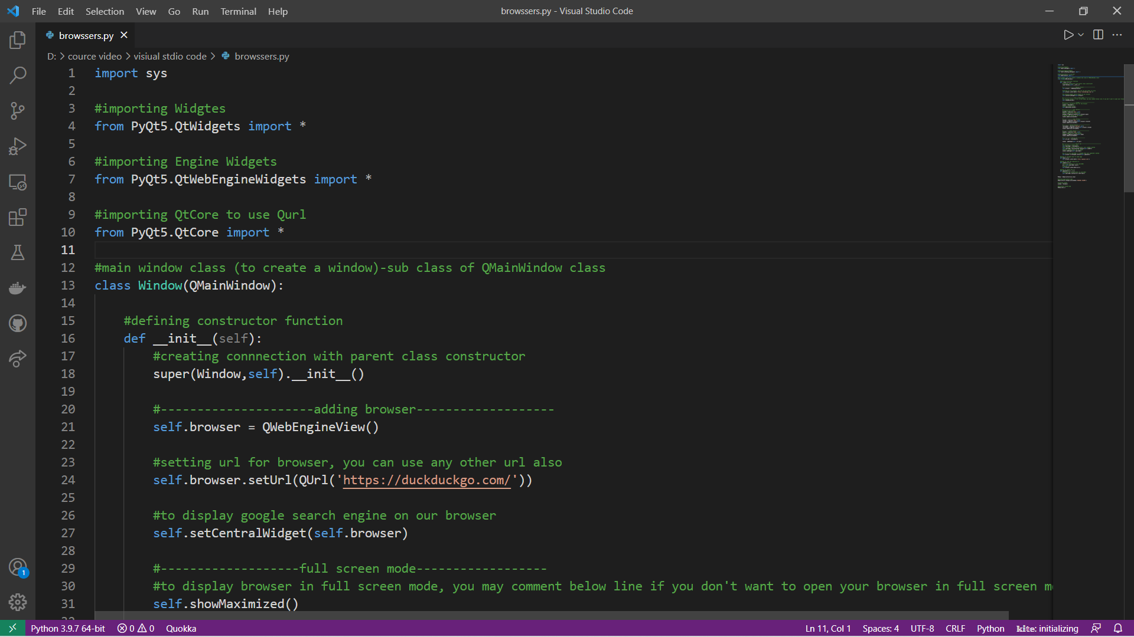

Slide 17
FINAL OUTPUT OF MY PROJECT

Slide 18
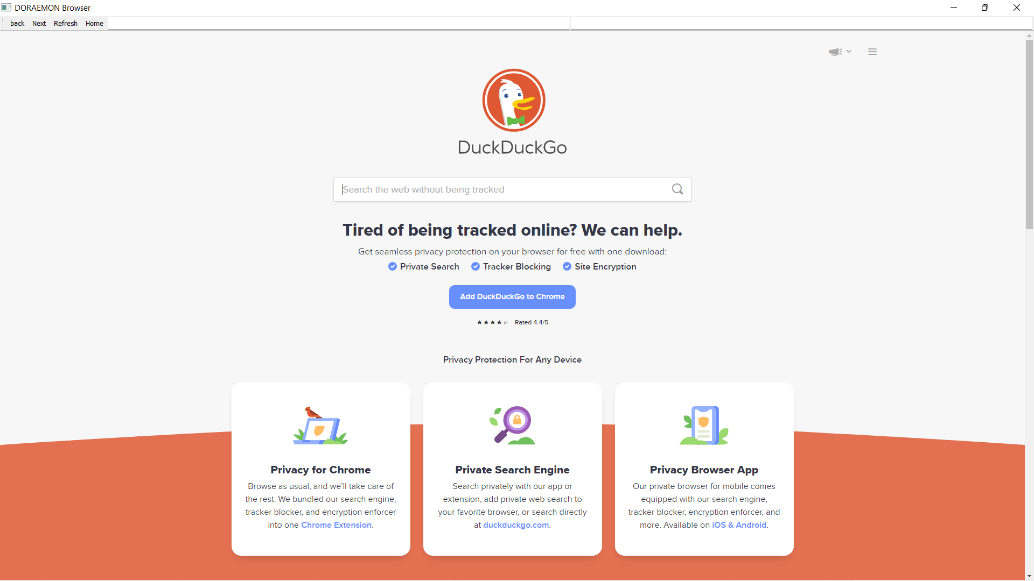

Slide 19
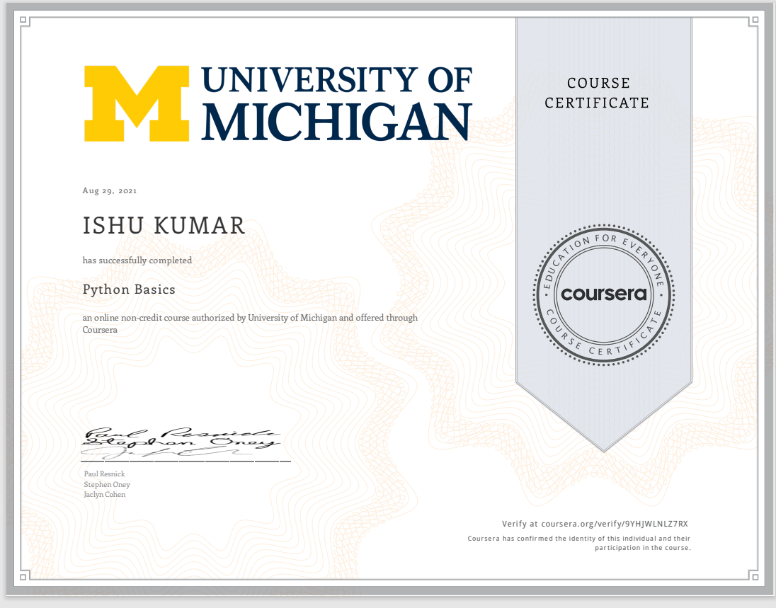
DIGITAL CERTIFICATE

Slide 20


